Slide 1
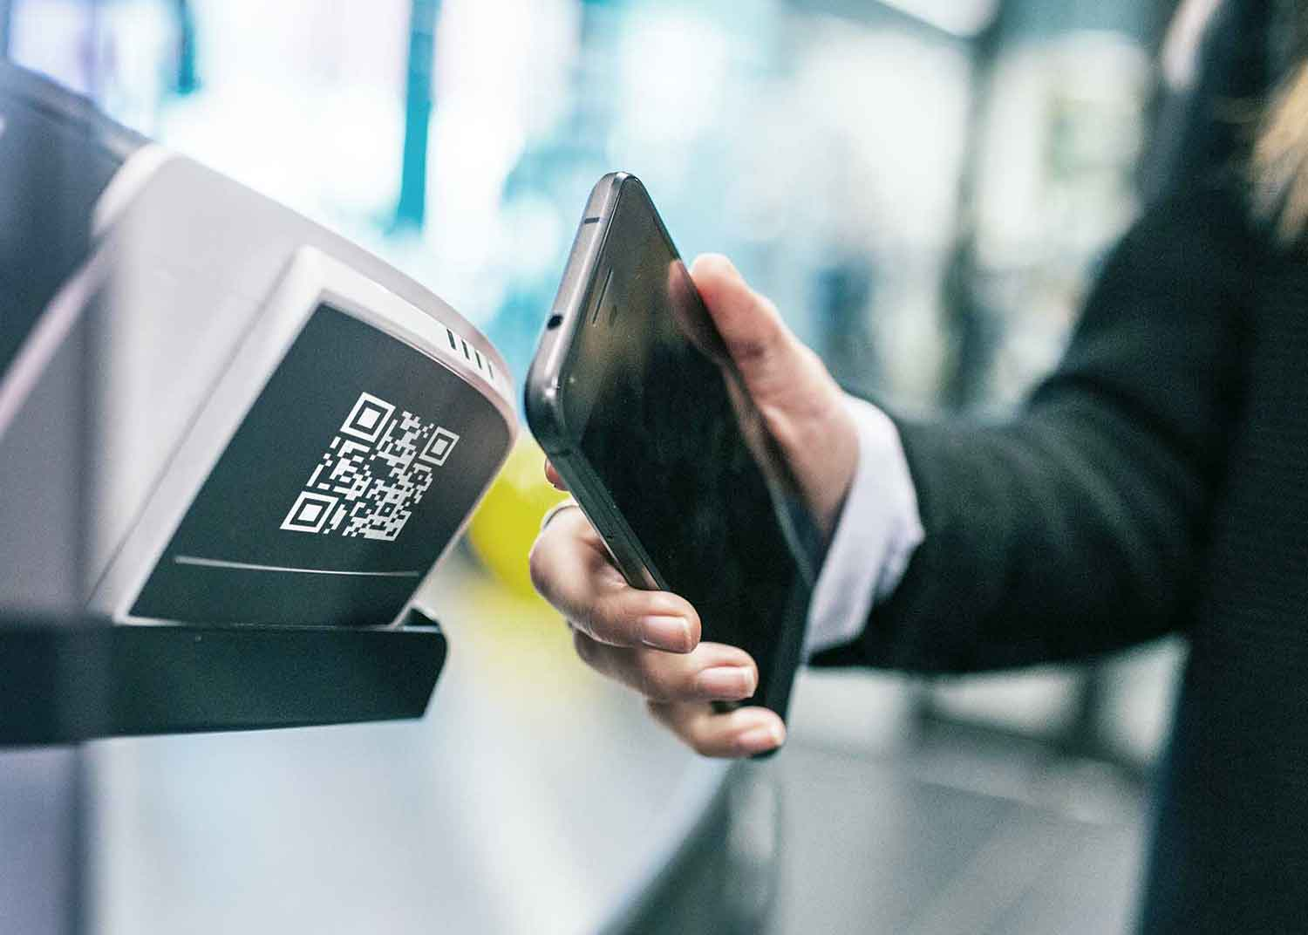
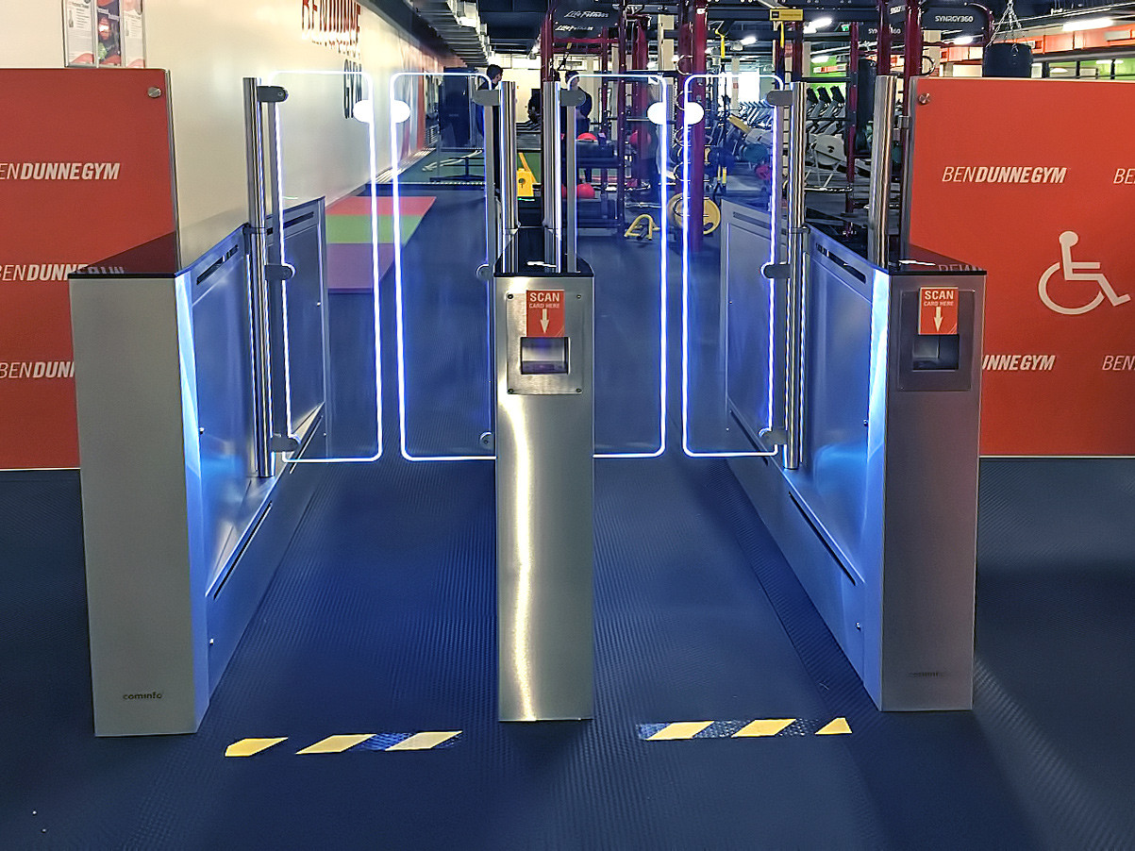
The accessing and information app
By: Abdallah Salhab

Slide 2
-Page 3:the problem -page 4: the solution -page 5: the goals/benefits -page 6: the management strategy -page 7: the budget -page 8: the requirements -page 9: the timeline -page 10: the conclusion

Slide 3
The problem:
These days the gym is relying on an accessing system that uses plastic key cards and those
Key cards are producing a lot of waste because they are not reusable, other thing is that the
accessing system has not been reliable in the last period and that bothers the customers.

Slide 4
The solution:
The solution is to install a new smart accessing system with access door that works by scanning
a QR code from the members phones.
The QR code is generated through an app that is also used to track the members training
And give them useful information about the workouts.

Slide 5
The goals The benefits
Having a reliable accessing system
Increasing the number of members
Having a helpful app
Reduce the use of plastic key cards
Having a special feature that others don’t have
Increasing the gym’s income
Increasing customer satisfaction

Slide 6
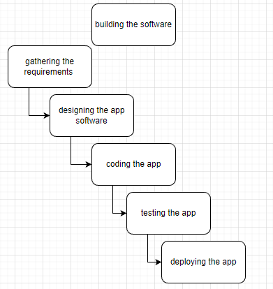
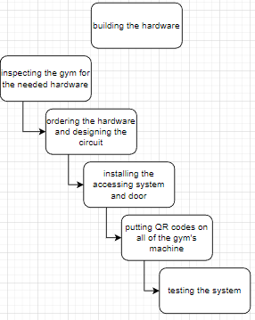
Management Strategy: This project is going to by done by the help of two teams; the hardware team and the software team, these two teams are going to work on the waterfall model especially in the software part because the system have been implemented before and the requirements are already there.
We are going to use the waterfall
Methodology and that is to run
Through the development steps of the
System sequentially and you can skip
A step before completing the currant
Step.
It was used because the system was
Developed and done before hand so
the steps are clear, and the
Mild stones are clear.

Slide 7
Budget:
Project activity | budget | percentage
The app software | 5480$ | 77%
The hardware installment | 480$ | 7%
The hardware | 1150$ | 16%
total | 7,110$ | 100%

Slide 8
The projects requirements:
-The software team
-The hard ware team
-The hardware that needs to be installed advised by the team

Slide 9
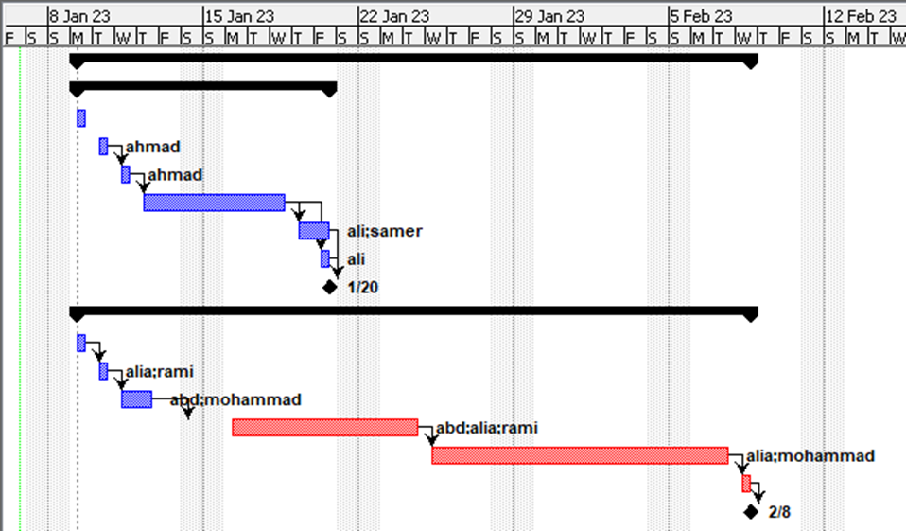
The project timeline:
There are two dead line’s:
The first one is for the hardware installing and it
takes 10 days and ends in 1/20/23
The second one is for the soft ware coding and
It takes 23 days and ends in 2/8/23 ending the
Project with it.
For the project to be successful the project has to be done in time and the project has to it’s
objectives in the best way

Slide 10
The conclusion: this project is going to replace an accessing system that uses plastic key cards with one that give members access using an app, this would reduce the amount of waste and would make the accessing system more reliable because it is harder for people to forget their phones that they would with the plastic key cards, the app has features like tracking the work out and it would give important information about it.

